Slide 1

HyperLogLog: Exponentially Bad in Adversarial Settings
Kenny Paterson and Mathilde Raynal
Applied Cryptography Group
21 October 2020, Zurich

Slide 2
Agenda
Introducing HyperLogLog (HLL)
Breaking HLL
Repairing HLL

Slide 3
HyperLogLog (HLL)
A Puzzle:
You have a small amount of memory and want to count the number of distinct items in a large collection of items X.
This is the problem of cardinality estimation.
How to do it?
How to do it when X is presented in a streaming fashion?
What if approximate counting is good enough?

Slide 4
HyperLogLog (HLL)
A Solution:
Suppose we have a hash function h: X → {0,1}^{n}.
Assume h has some suitable uniformity property.
Look at the bits of h(x) for each item x and keep track of maximum position of the leftmost 1 bit; call that position M.
10000110: M = 1
01101100: M = 2
11001011: M = 2 (no increase)
00010010: M = 4
Set:
cardinality estimate = 2^{M}.

Slide 5
HyperLogLog (HLL)
A Solution:
Set:
cardinality estimate = 2^{M}.
Intuition: for a random selection of about 2^{M} distinct values x, expect to see the length M string 0^{M-1}1 as a prefix of h(x) once.
Storage required? log(M) bits, hence only loglog(2^{M}) bits.
This provides a statistically unbiased but not very accurate estimator.
Combine many such estimators to improve accuracy.

Slide 6
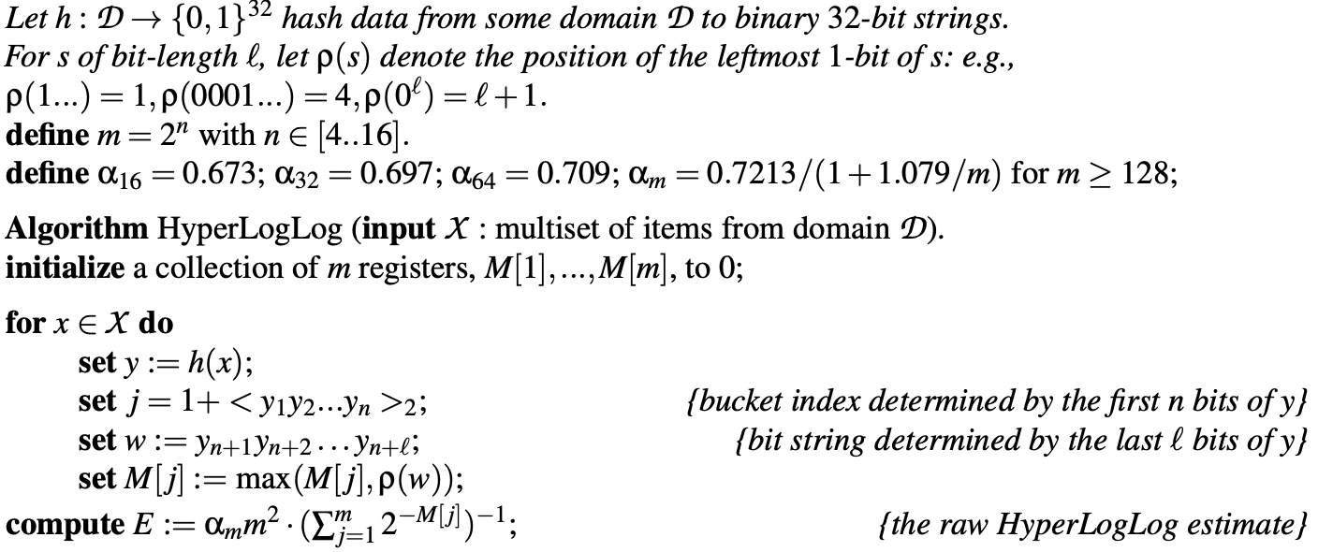
HLL According to Flajolet et al. (2007)

Slide 7
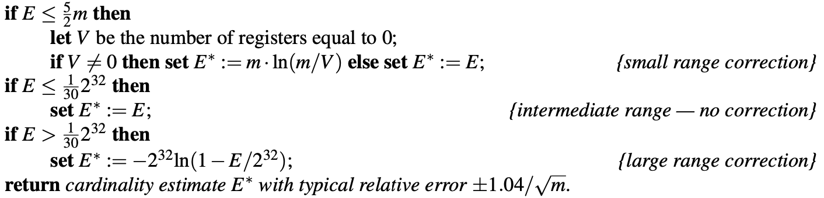
HLL According to Flajolet et al. (2007)

Slide 8
HyperLogLog (HLL)
HLL is increasingly used in real-world applications, including those where the inputs may be adversarially chosen.
Example 1: detecting anomalous network behaviour, such as port scans.
Example 2: counting distinct network flows and using the results to perform congestion control.
Example 3: counting Facebook users.
HLL is widely implemented, e.g. Redis, Google BigQuery, Apache Spark and Druid.

Slide 9
Breaking HLL

Slide 10
Breaking HLL
Core idea:
Assume adversary knows hash function h: X → {0,1}^{n+l} and can select which values x are inserted into the HLL sketch.
Look at the bits of h(x) for each item x and insert only those which begin with "few" zero bits.
This keeps all bucket values M[j] small, and hence also keeps the raw HLL estimate small, even though many items x are inserted.
What if the adversary does not even know the hash function?
Can we find better attacks?
Does it help the attacker to have access to the HLL cardinality estimates? Or even to know the contents of all the buckets?

Slide 11
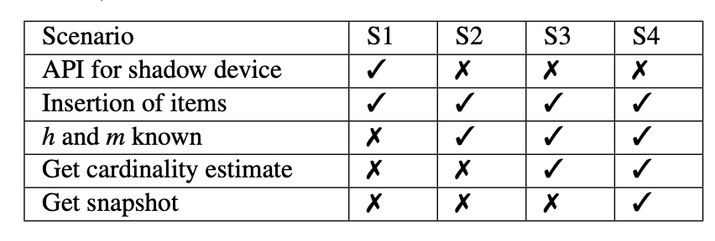
Breaking HLL – Adversary Models
S1, S2: P. Reviriego and D. Ting, “Security of hyperloglog (HLL) cardinality estimation:
Vulnerabilities and protection,” IEEE Commun. Lett., vol. 24, no. 5, pp. 976–980, 2020.
S3, S4: D. Desfontaines, A. Lochbihler, and D. Basin, “Cardinality Estimators do not
Preserve Privacy,” in Proceedings on Privacy Enhancing Technologies, pp. 26–46, 2019.

Slide 12
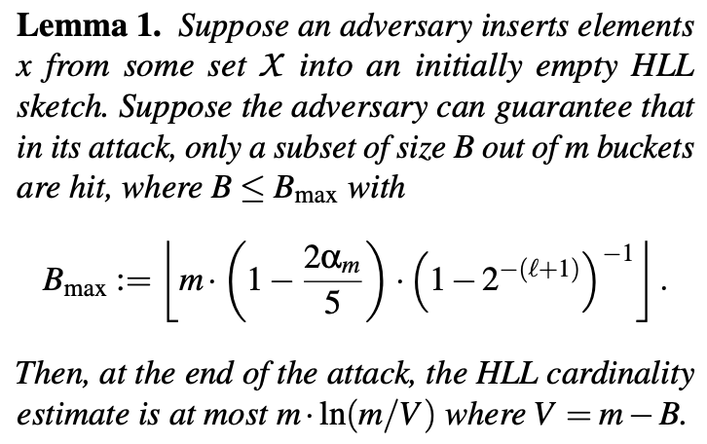
Breaking HLL Better
Approximately 1
Approximately 0.71
Small range correction

Slide 13
Breaking HLL Better
So an attacker can hit about 71% of the buckets with any values M[j] and still stay in the “small range correction” zone!

Slide 14
Breaking HLL Better
Example:
Set B = m/2.
Then, in S2, the attacker can expect to insert 1/2 of all inputs and keep cardinality estimate to 0.693m.
Set B = 1.
Then, in S2, the attacker can expect to insert 1/m of all inputs and keep cardinality estimate to 1!

Slide 15
Repairing HLL
In S1, the adversary is assumed to have access to a shadow device, an exact replica of the target HLL.
Our attacks in S1 are agnostic to the internals of the HLL implementation – they work as long as the shadow device and target device are identical and we have insert, read, and reset access to the shadow device (and insert access to the target)
No dice, cryptographically speaking.
And we have quite strong attacks in this setting.
But this setting does not make much practical sense (to us).

Slide 16
Repairing HLL
In S2, S3, S4, there is hope!
Consider replacing h(⋅ ) with a keyed PRF F(K,⋅ ).
Then the adversary is effectively reduced to the ideal (random input) case, where it cannot influence the cardinality estimate.
We built a formal security model to analyse this.
S4 adversary has access to insert, read, corrupt queries.
Adversary has to distinguish real HLL (y ← F(K,x)) from ideal HLL (y ←$ {0,1}^{n+l}).
Easy to prove a reduction to PRF security of F.

Slide 17
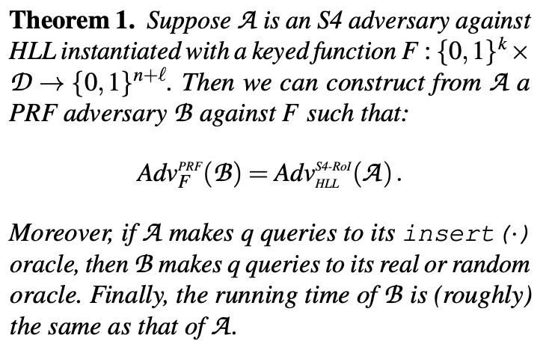
Repairing HLL

Slide 18
Repairing HLL
Instantiating the PRF:
Inputs x typically short.
We want a short-input PRF that is as fast as non-cryptographic hash functions like Murmur3, etc.
Solution: SipHash (Aumasson and Bernstein, 2012).
Has withstood some cryptanalysis attempts.
For 90-byte inputs:
HMAC-SHA-256: 705ns
SipHash-2-4: 102ns
Murmur3-128: 60ns

Slide 19
Closing Remarks
HLLs are widely used.
They are completely insecure in the face of adversarially-selected inputs.
We can break and repair them.
This was a fun project to do!
It came out of Mathilde‘s Semester Project which was initially quite open-ended.
Now in the lap of the gods (aka USENIX Security program committee).
See also: D. Clayton, C. Patton, and T. Shrimpton, “Probabilistic data structures in adversarial environments,” in CCS 2019.

Slide 20
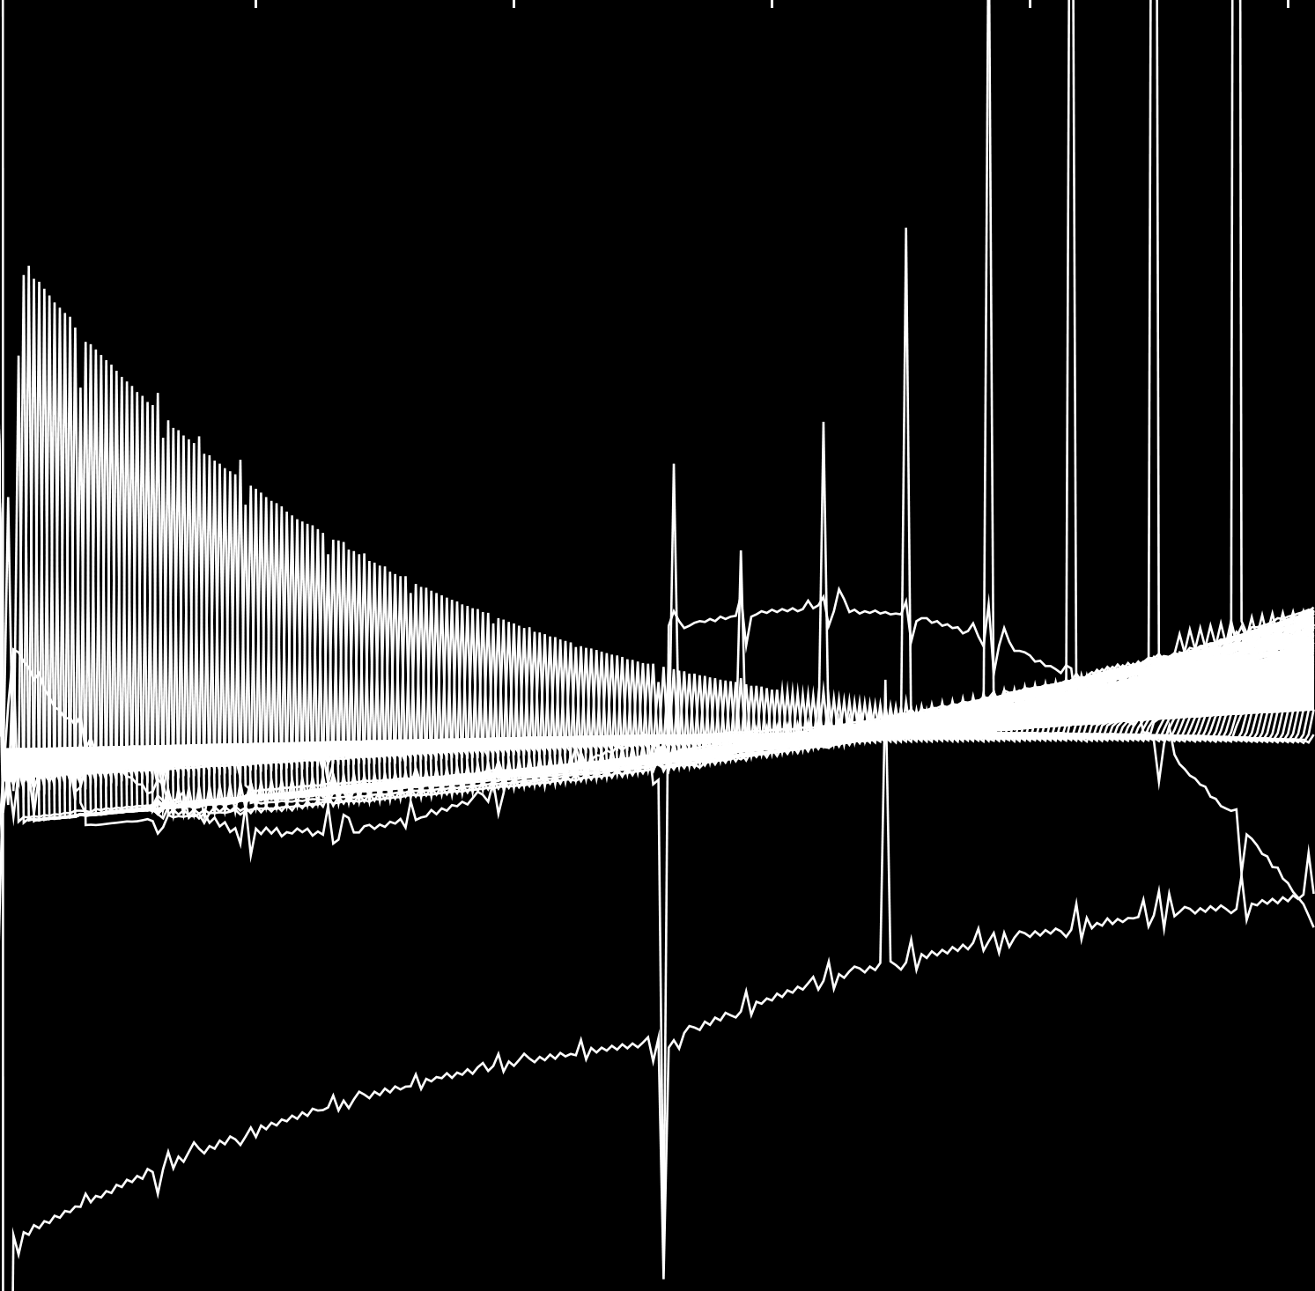
Contact:
Professor Kenny Paterson
Applied Cryptography Group
kenny.paterson@inf.ethz.ch
ETH Zurich
Applied Cryptography Group
Department of Computer Science
Universitätstrasse 6 8092 Zurich, Swizterland
https://appliedcrypto.ethz.ch/

